Slide 1





Oct 16, 2019
Micro Frontends
with Angular
and single-spa
+
Matt Gold
Tech Lead at Kabbage
@mattbgold

Slide 2
ng update

Slide 3


Slide 4
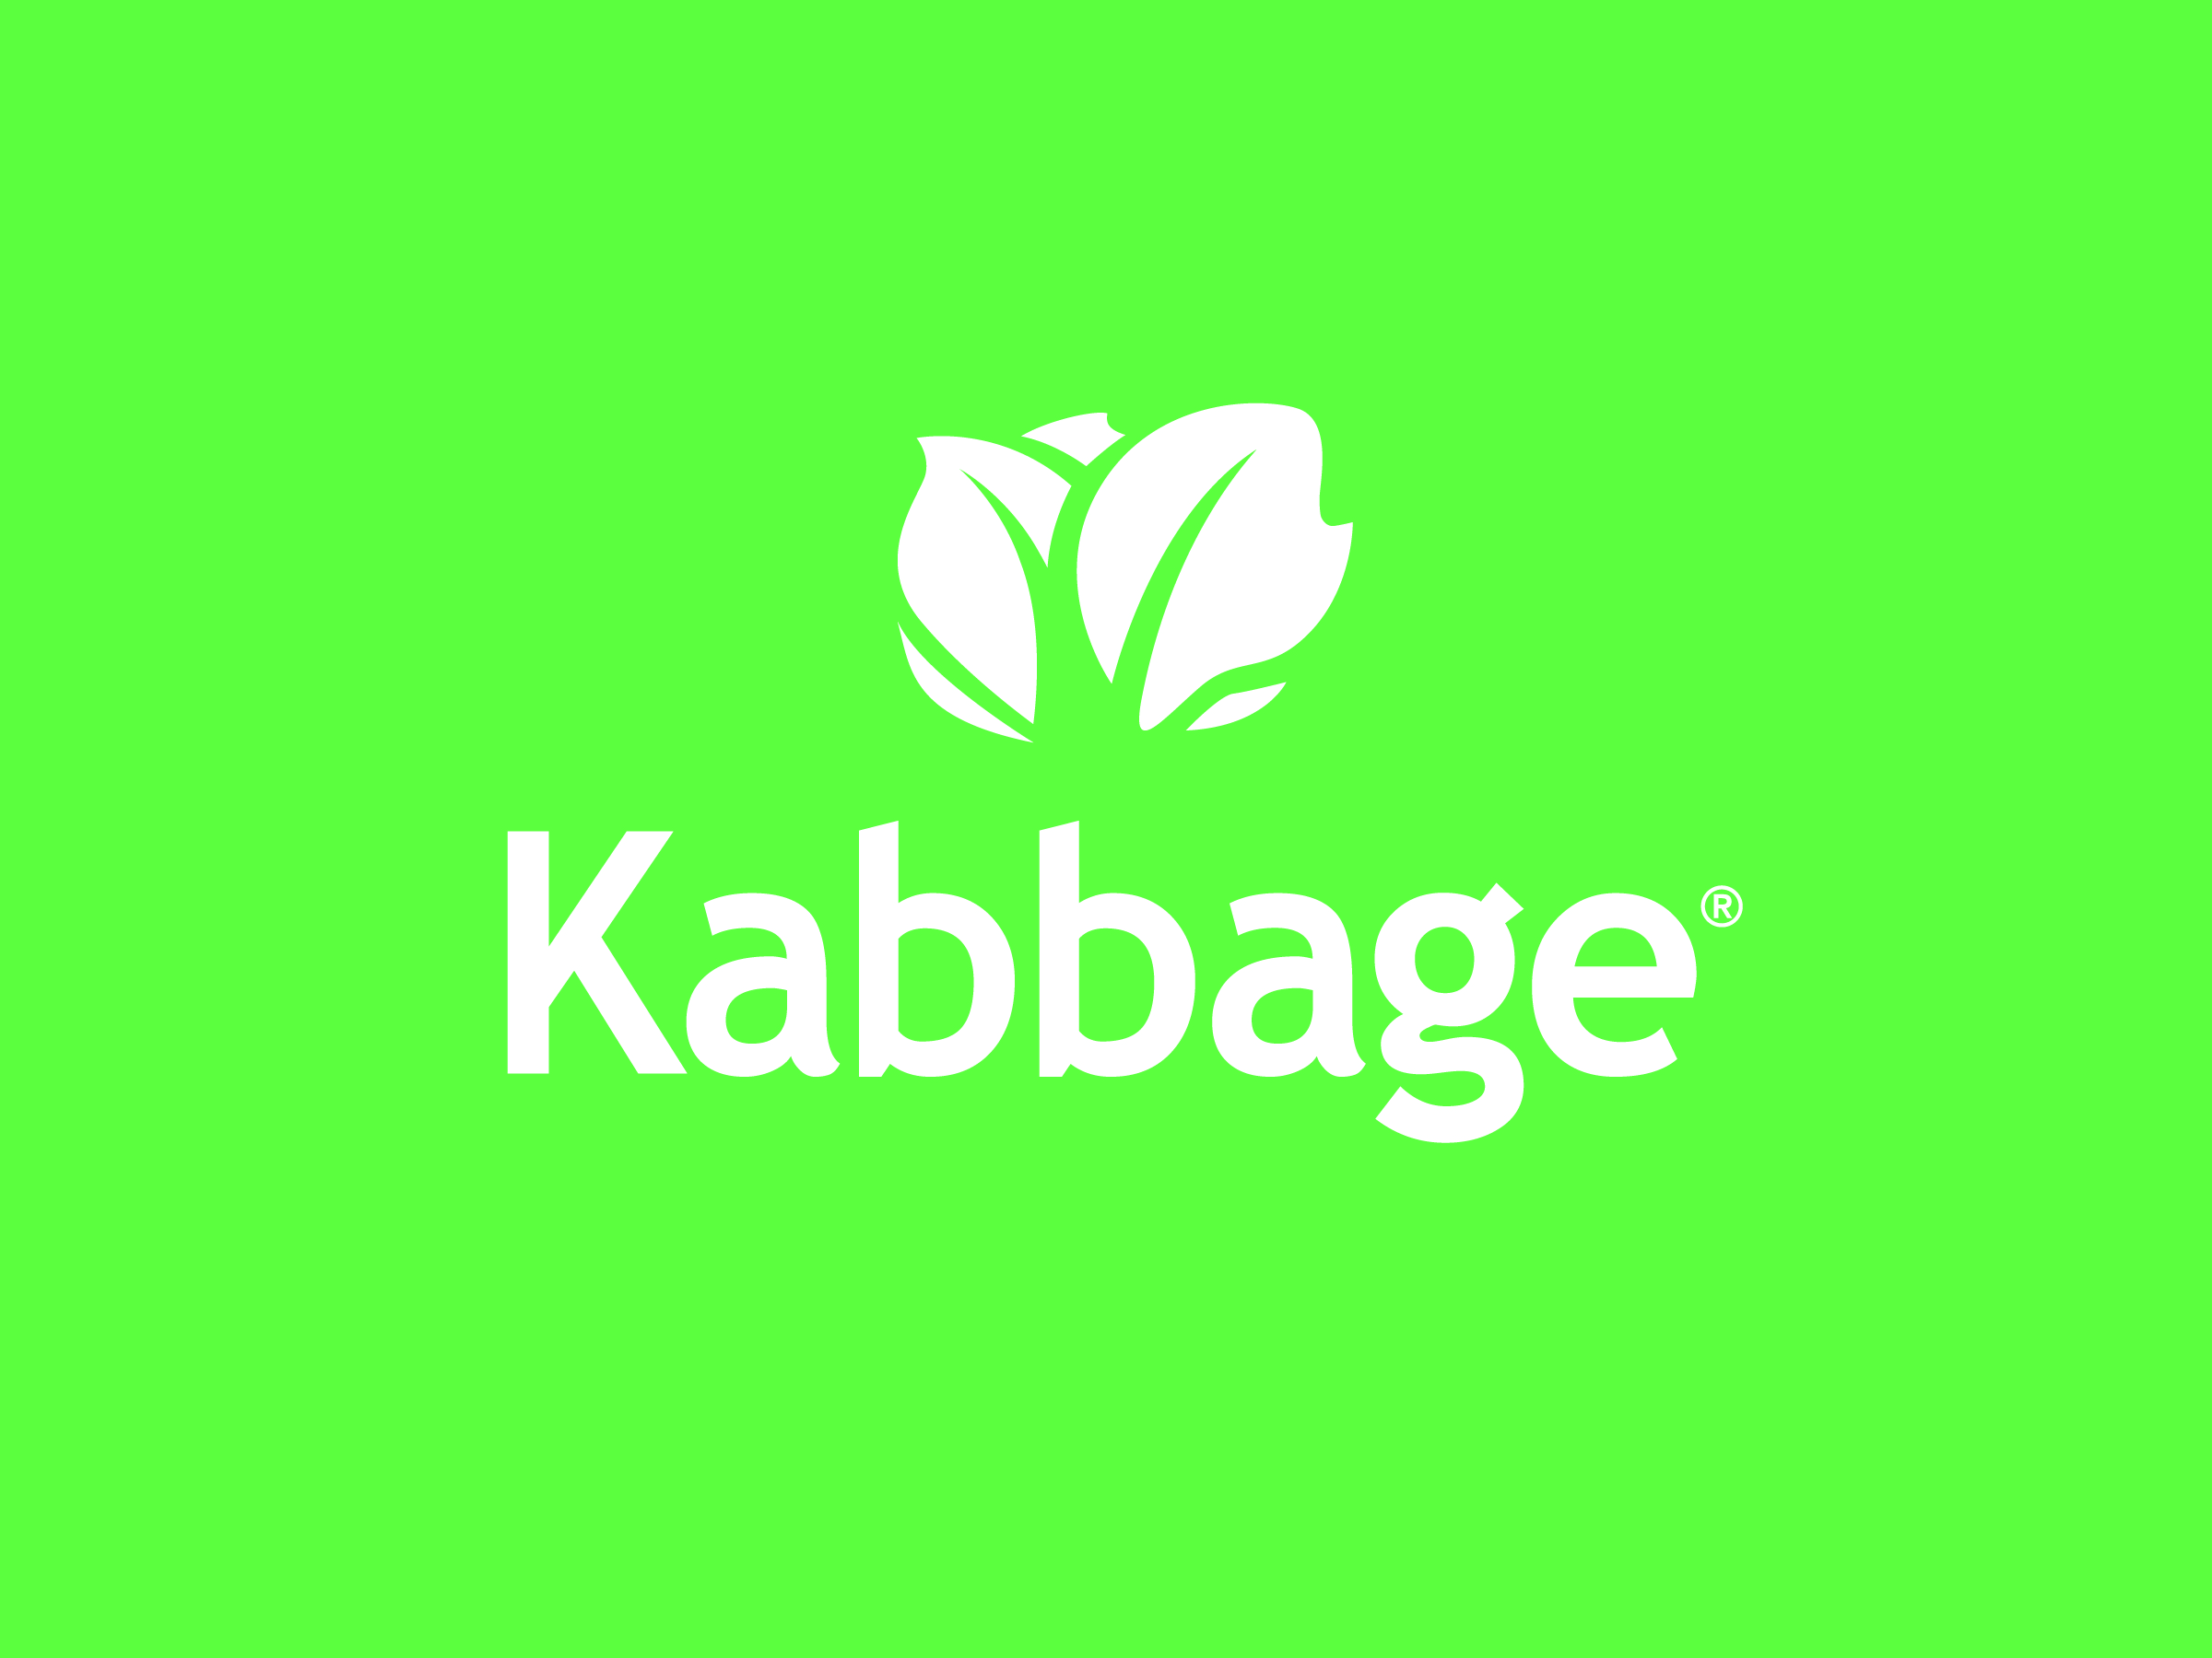

Slide 5
Oct 16, 2019
Micro Frontends
with Angular
and single-spa
+
Matt Gold
Tech Lead at Kabbage
@mattbgold
Notes:
Quick summary of the talk + demo
Introduction to microfrontend technique + single spa
Explain the demo

Slide 6

How to architect a web application?
Notes:
Before we talk about microfrontends, let’s take a look at some of the other ways we build web applications.

Slide 7

Monolith
Application
UI
Business Logic
Tightly coupled
Difficult to scale properly
Reduced agility
Difficult to maintain
Locked into technology
Data Access
DB
Notes:
So, this is a familiar approach.
We have an N-tier architecture, but all of our code is together in the same project. It builds together, deploys together, and runs together.
This appraoch has its benefits. It’s easy to set up and easy to work with, but as your project and organization grow, you start to run into some issues.
Tightly coupled - low reusability
Not Scalable - can’t scale independently
Reduced Agility - Scary Deployments
Difficult to maintain - Difficult to grok
Tech Lock-in

Slide 8
Microservices
UI
Easier to maintain
Scale Independently
Release Fast & Often
Team autonomy
Orders
Cart
Items
Profile
DB
DB
DB
DB
Notes:
Microservices have been around for awhile and provide solutoins to these problems.
Instead of having one giant system that does everything, you split it up into smaller services that each do one thing.
Easier to maintain -

Slide 9

UI
Oh, in here? Everything is totally fine.
Notes:
UI is growing - more complexity is shifting from back to front end.
Describe problems with monolithic front end.

Slide 10

Wait, this sounds familiar...
Haven’t we solved these problems already?

Slide 11

Introducing...
Micro Frontends

Slide 12
“An architectural style where independently deliverable frontend applications are composed into a greater whole”

Slide 13
Micro Frontends
Container App
Orders UI
Item Listing UI
Edit Profile UI
Shopping Cart UI
Orders
Cart
Items
Profile
Notes:
Our front end monolith from before is split into these “microservices” in the browser.

Slide 14
http://myapp.com
Welcome to My App! Log Out
http://overview.myapp.com
Notes:
So what does this look like?

Slide 15
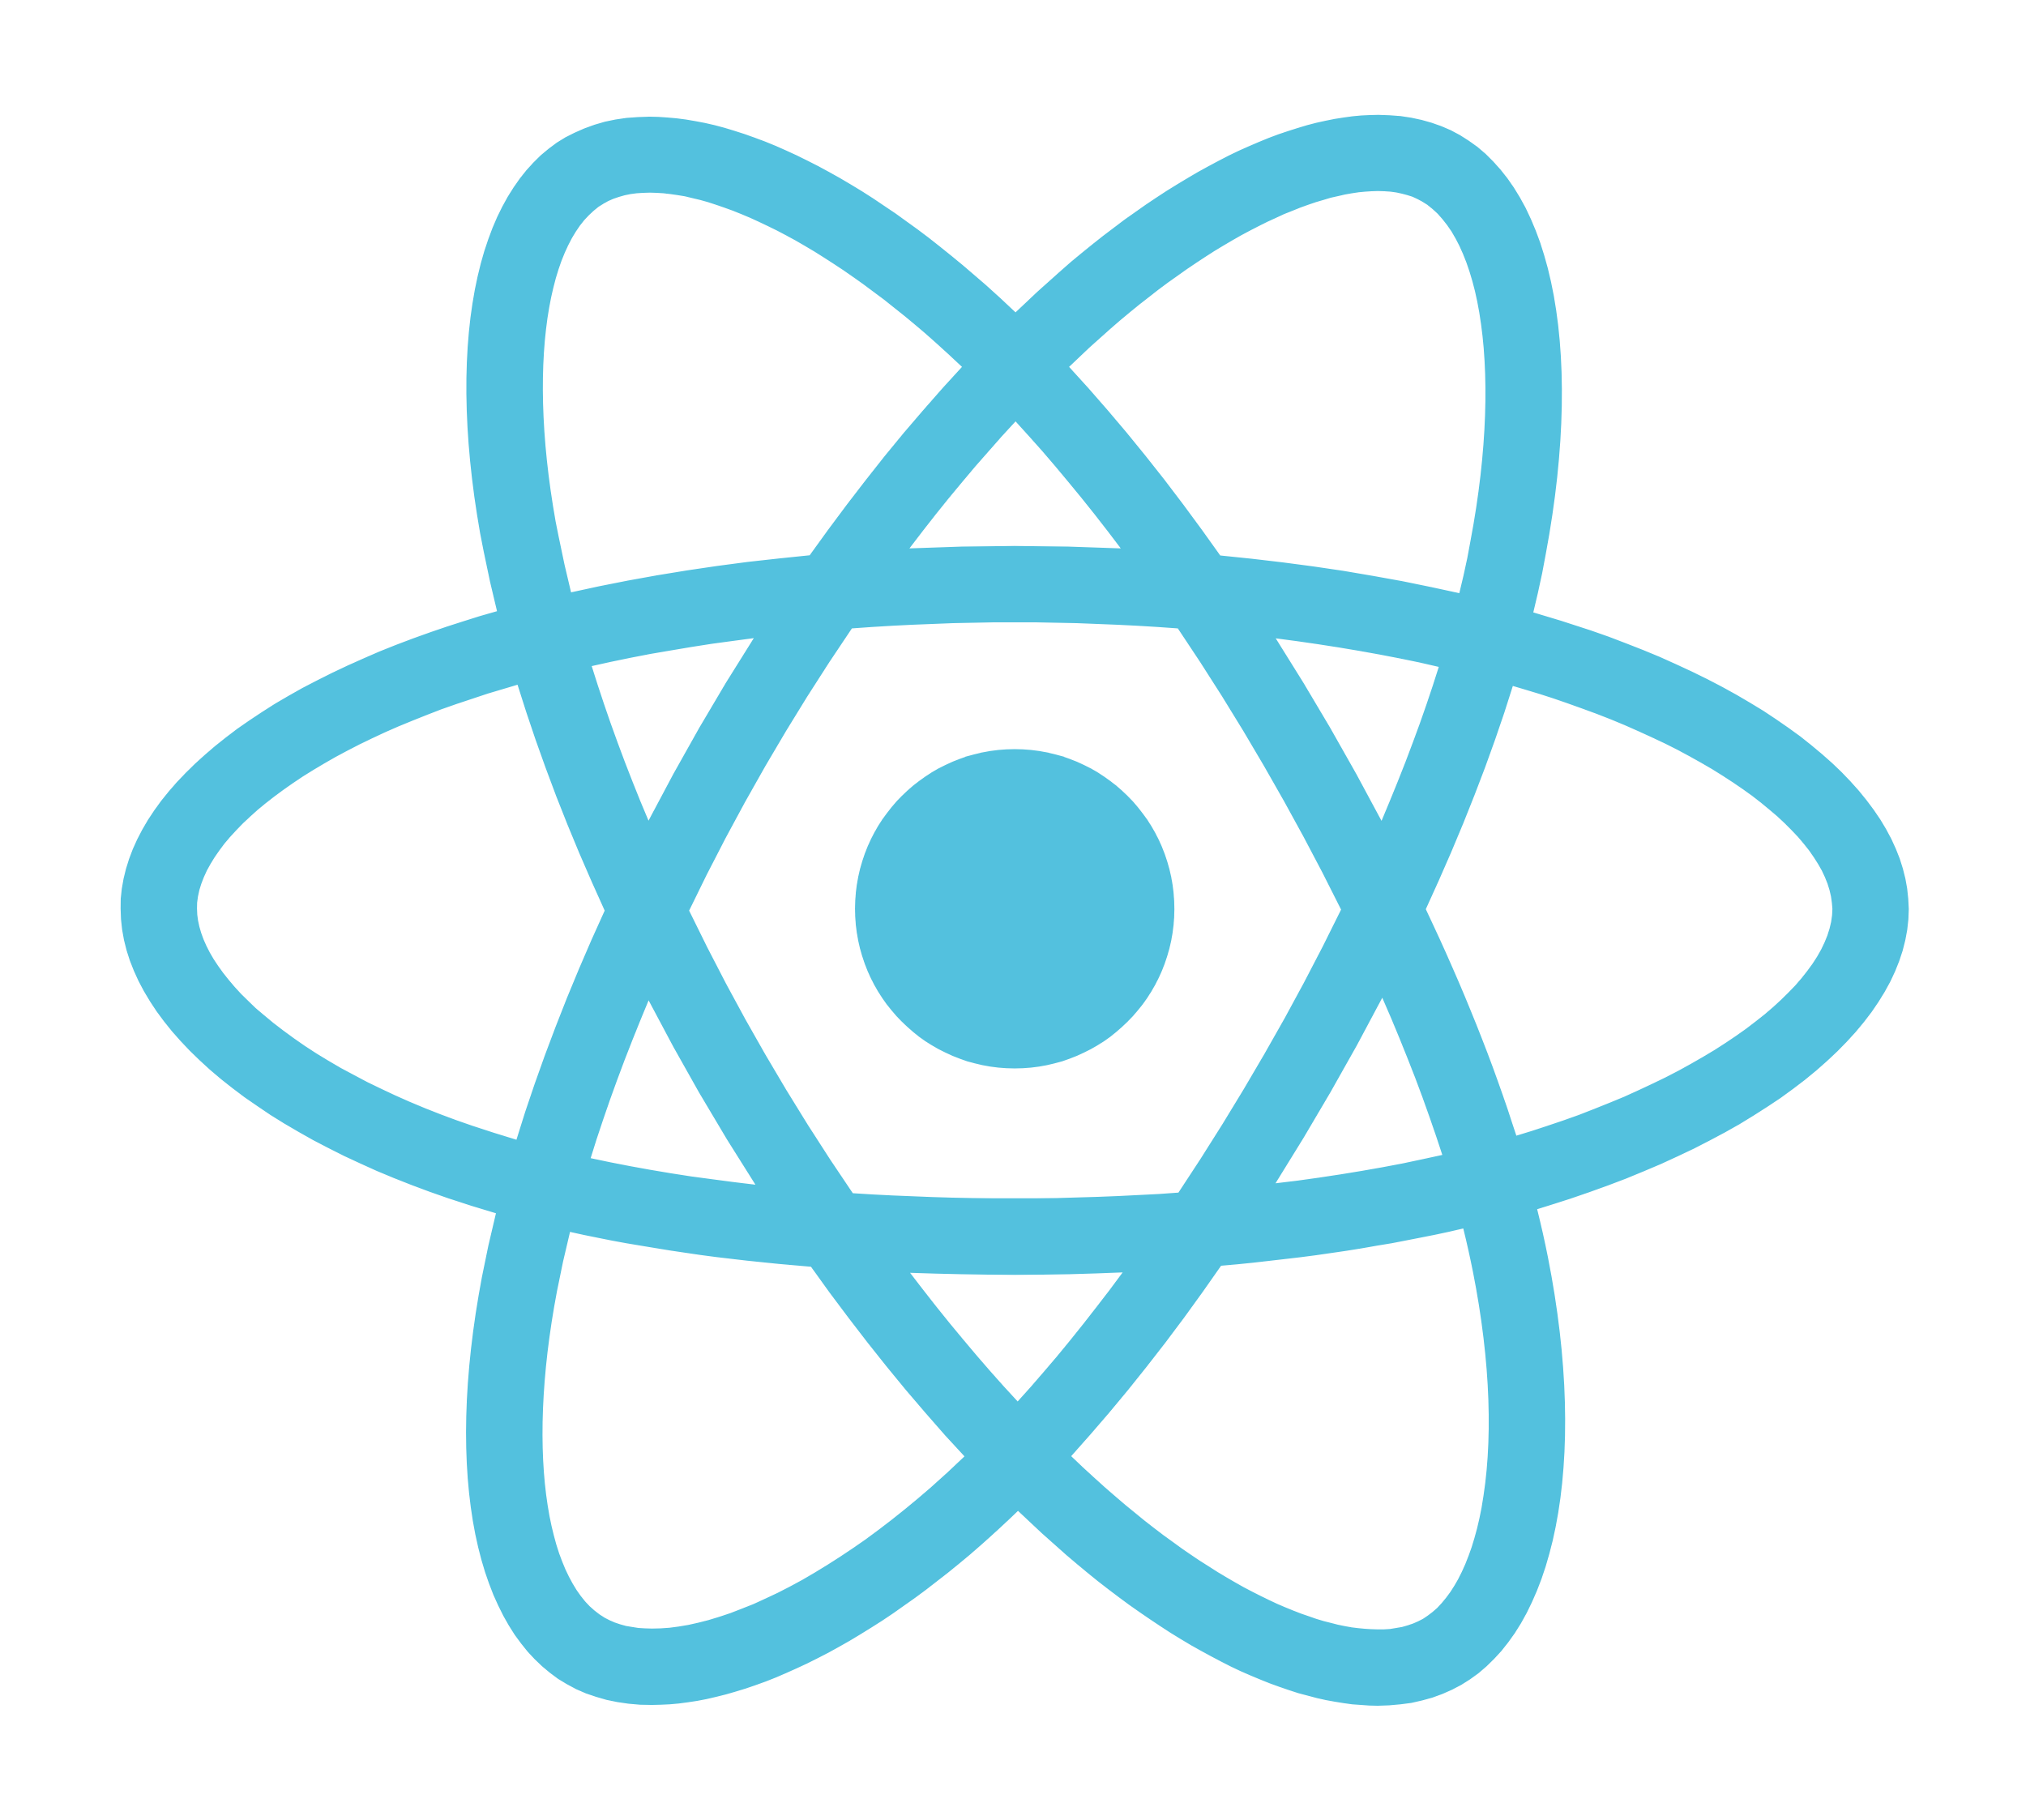
http://myapp.com/orders
Your Orders
http://orders.myapp.com
http://sidebar.myapp.com

Slide 16

Micro Frontend Applications
Micro applications are independently deliverable
Developed Independently
Tested independently
Deployed Independently
Notes:
The key here is that micro frontends be independently deliverable.

Slide 17

Sounds great...
But how do we implement this?

Slide 18
Micro Frontend Solutions
There are several options.
Navigate between separate apps with a shared auth session.
IFrames
Web Components
Runtime integration with JavaScript

Slide 19
single-spa
A framework for orchestrating micro frontends.
https://single-spa.js.org/

Slide 20


Slide 21
Single-spa application lifecycle
bootstrap()
mount()
unmount()`
All single-spa applications must implement these three lifecycle methods. The framework handles the rest for you.

Slide 22
Single-spa Ecosystem
single-spa-angular
single-spa-react
single-spa-vue
single-spa-angularjs
… (and many more)
Single-spa provides helper libraries for all popular front end frameworks.
These helpers implement the lifecycle methods for you, and provide other useful tools for building micro frontend apps.

Slide 23
Single-spa Concepts
Applications
Lifecycle managed by single-spa activity function.
Parcels
Lifecycle managed explicitly by your code.

Slide 24
Splitting Up Your Applications
Monorepo
😄 Easy to set up.
😥 Tightly coupled. Deploy everything together.
NPM Modules
😐 Harder to set up.
😐 Looser coupling, but root application needs to be frequently deployed.
Dynamic Module Loading
😥 Hardest to set up.
😄 True decoupling. Fully independent deployments.

Slide 25
Options for Dynamically Loading Apps
Into Single-Spa
Plain old script tags!
<script src=”https://my-app.com/main.js”></script>
Module Loaders!
SystemJS
RequireJS
jspm
Supports all module types (ES6, CommonJS, etc),
Polyfills import-maps
Notes:
Module loaders, unlike bundlers such as webpack or browserify, load JavaScript modules at run-time.
Import maps happen to be extremely useful for our use case.

Slide 26
Import Maps
Provides an abstraction over module paths. This allows us to refer to our apps by name in code, while dynamically configuring their remote location :
<script type="systemjs-importmap">{
"imports": {
"my-app": "https://my-app.com/main.js?version=1.5.2342"
}
}</script>
...
System.import(`my-app`).then(...)
Notes:
SystemJS + import maps is the recommended setup for single-spa

Slide 27

Common Myths
About Micro Frontends

Slide 28
“Micro frontends require framework libs to be downloaded again in each app, drastically increasing bundle size.”
This is solvable, it just requires some extra setup:
Exclude shared dependencies from your bundles, e.g. using webpack externals.
Use global scope or import maps to provide the same dependencies at run time to all of your apps.

Slide 29
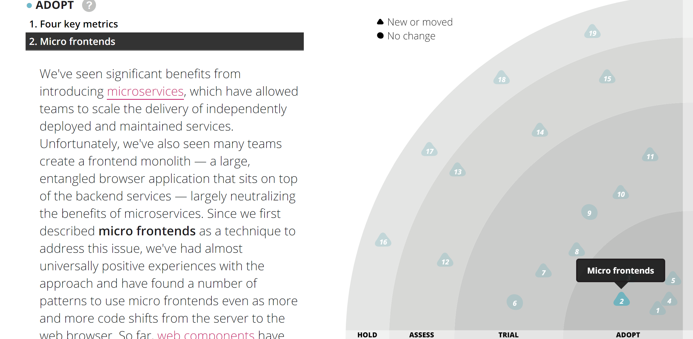
“Micro frontends are not a proven technique. It’s too early.”
Micro Frontends have achieved “Adopt” status on the Thoughtworks Technology radar.

Slide 30
“Micro frontends advocate using multiple frameworks and versions in the same application.”
This is a notable and often-cited capability of micro frontends, but it is generally not recommended to do this.
It prevents us from sharing dependencies, and introduces more skillsets needed to maintain your application.
There are use cases for this however, e.g. gradually migrating a large app from a legacy framework to a new framework.

Slide 31
demo
Building an Angular Micro Frontend
Notes:
Things to go over in the demo
OPEN CONTAINER APP
EXPLAIN INSTALLED DEPENDENCIES IN ANGULAR JSON
- angular.json - SHOW GLOBAL SCRIPTS
SHOW MAIN.TS
SPA-HOST-COMPONENT
- show the component
- show the routes
SINGLE-SPA-SERVICE
- show the service
IMPORT MAPS (show how we map that name from the route to the module)
- assets/import-map.json
- index.html
SETUP CHILD1----------------------------------------
----- ng new child1
- change app prefix
- > ng add single-spa-angular
- ZoneJS
- update port in serve:single-spa
- declare EmptyRouteComponent in the main app module
- in routing module, add route for empty route AND provide APP_BASE_HREF useValue: '/'
--------------------------------------------------------
ROUTE REUSE STRATEGY
add console.log to spa-host, then route internally
BUILD-LOCAL and SERVE-LOCAL in CHILD2 IF THERES TIME
- angular.json
- package.json
const routes: Routes = [{
path: '**',
component: EmptyRouteComponent
}];
@NgModule({
imports: [RouterModule.forRoot(routes)],
exports: [RouterModule],
providers: [{ provide: APP_BASE_HREF, useValue: '/' }]
})
RESOURCE HINTS
<link rel="prefetch" href="http://localhost:4202/main.js" as="document">

Slide 32
Next Steps
Prefetch applications using resource hints. Take it even further with Guess.js
Use webpack externals and import maps to remove shared dependencies from app bundles. (Huge savings)
Deploy micro-app bundles to CDN under dynamic url and sync with import maps using remote configuration.
Use NPM packages to share code and prevent duplication across micro-apps.
Create a design system, or use an existing one like Material.

Slide 33
Downsides of Micro Frontends
Challenging to set up initially.
Complex infrastructure, just like with microservices.
Having dedicated DevOps helps.
Local development and QA are more complex.
Really needs a design system and infrastructure to easily share code and UI components.

Slide 34
Oct 16, 2019
Resources
https://single-spa.js.org/docs.html
https://martinfowler.com/articles/micro-frontends.html
https://bit.ly/2tjZCng - Intro to module loaders.
https://github.com/WICG/import-maps
Matt Gold
Tech Lead at Kabbage
Animated Gifs by 100% soft (https://100soft.us/)
@mattbgold

